Slide 1
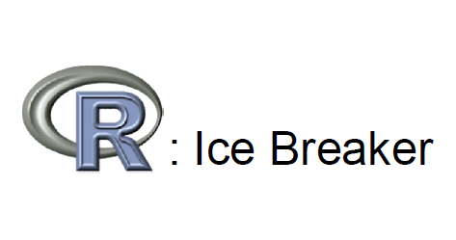

Slide 2
Learning Goals
What is R?
Why we use R?
How to read data into R
Getting familiar with basic commands &coding
More of R: What next?

Slide 3
R: What is it and Why we use it
Open-Source, cross platform, free Statistical Language
and Program
• Works on Windows, Mac-OS, Linux, Unix platforms
Flexible: own functions, modify existing
function/commands to suit your purpose
Powerful: Open source, Constantly being updated by
users ( Scientists, Statisticians, Researchers, Students!)
And: Beautiful Graphics, Facilitates research, comes
with an enormous library of pre-defined functions, can
be integrated into many environments and platforms
such as Hadoop etc

Slide 4
Installing R
Can be downloaded for free from
http://www.r-project.org/
Download the version compatible with your
OS
Simple/Standard installation process

Slide 5

R: Working Directory (WD)
Some location/Folder on your PC where you have the data, code etc
You want to import files, code from this location
You want to save your output here
Setting a WD on starting your R session makes
importing, exporting data files, code files etc Easier

Slide 6
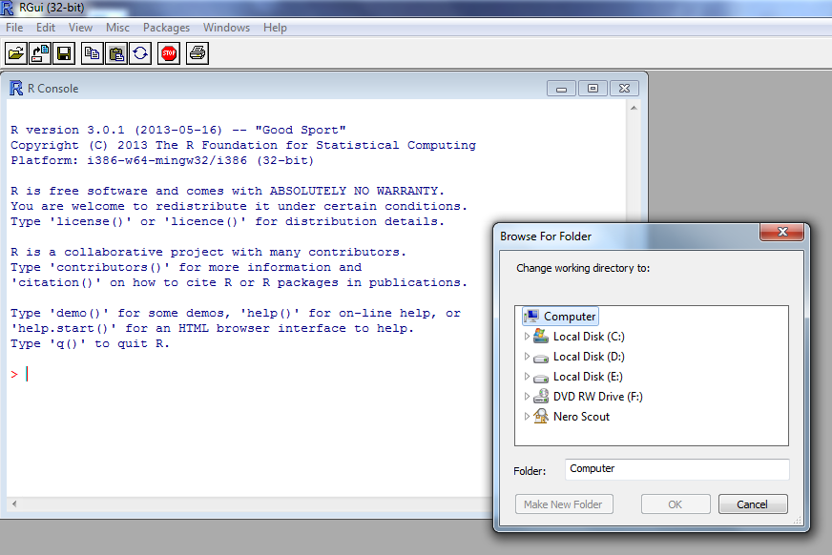
R: Working Directory
File--change dir..

Slide 7
Interacting with R
We have seen in the console the command prompt ‘>’,
indicating that we must begin entering our command
Basic Rule: Type a command and hit enter to execute it
E.g. x<-1:100 (create a vector of length 100, with elements 1,2,3,4……..100)
Write code, select the part you want to run and ‘ctrl+R’ to execute

Slide 8
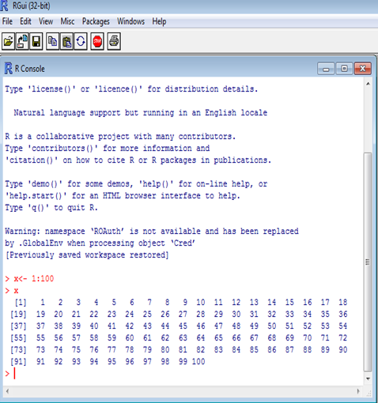

Slide 9
R Console: As a Calculator
Type this in the console:
>12+5 hit Enter
Let us try something more complex:
> (12+5)*(39-13) /45 Hit Enter
Can be used like any other calculator
WARNING: Beware of lurking square brackets
[(12+5)*(39-13)]/45 hit Enter
We will see later on in this tutorial that ‘[]’
means something else in R.
Much more than a calculator

Slide 10
R Commands
Are mostly in the form of functions
E.g.: plot(x,y), mean(x)
How do we tell R what x and y are?
– We can assign values to x and y ourselves
– Or import a dataset that contains x and y
– We will learn this through examples

Slide 11
R: The Very Basics
Essential basics to move forward with R:
– Create your own Objects (Variables, Vectors,
Matrices, Lists etc)
– Assign names to these Objects
– Learn to access an Object or any subset/part of it
– Perform simple calculations, transformations on
these objects

Slide 12
R: The Very Basics
Vectors
Suppose you own 5 cars
– Type: Compact, Minivan, SUV, Roadster and a Pickup Truck
– Mileage: 1256,237,6780,1000,12000
Let us define our first vector using the ‘c’ function in R, which “Combines Values into a Vector or List”
Vector Mileage
– Create the vector:
c(1256,237,6780,1000,12000)
– Assign the name ‘mileage’ to this vector using ‘<-’
mileage<-c(1256,237,6780,1000,12000)

Slide 13
R: The Very Basics
Vectors contd…
– Vector “type”
type<-c(Compact, Minivan, SUV, Roadster,Pickup Truck)
For creating a vector of string components, we use “ “ to separate the elements.
This would work:
type<- c(“Compact”, “Minivan”, “SUV”, “Roadster” , ”Pickup Truck”)

Slide 14
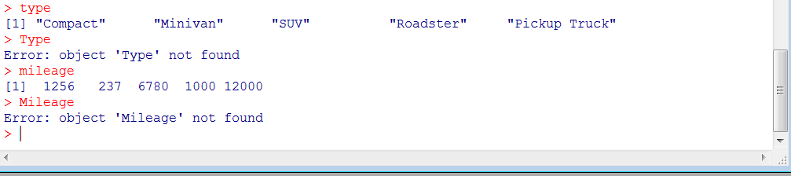
R:Tip 1
R is Case Sensitive

Slide 15
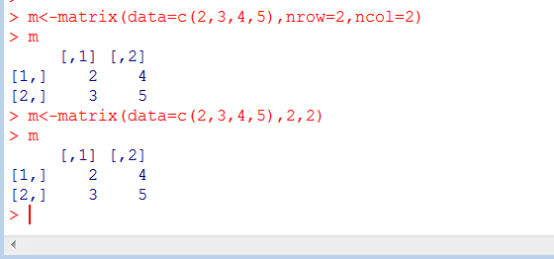
R: The Very Basics
Matrices, Data Frames
Create a simple 2x2 matrix, lets call it ‘m’:
m<-matrix(data=c(2,3,4,5),nrow=2,ncol=2)

Slide 16
R: The Very Basics
Matrices, Data Frames Contd…
Consider the 5 cars in our previous example, along with ‘type’ and ‘mileage’ , the following data is also available:
– Price, price<-c(36790,3445,66789,2455,76889)
– Number of cylinders in the engine,
no.cyl<-c(3,4,4,4,4)

Slide 17
Data Frames
Data frames (two-dimensional objects): can hold numeric, character or logical values. Within a column all elements have the same data type, but different columns can be of different data type.
Create a Data Frame that contains all this information:
cars<-data.frame(type,price,mileage,no.cyl)

Slide 18
Tibble DF
Tibble DF
  Tibble is a lighter version or a smaller version of a df with easier read and write access.
  It is part of the tibble library.
To convert any DF into tibble
  Library(tibble)
    Var <- tbl_df(data.frame)

Slide 19
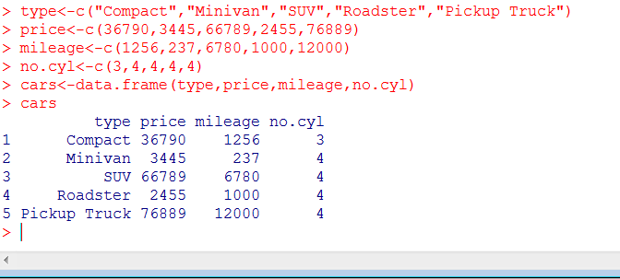
Data Frames

Slide 20
Lists, why would you need them?
list in R is similar to your to-do list at work or school: the different items on that list most likely differ in length, characteristic, type of activity that has to do be done, …
A list in R allows you to gather a variety of objects under one name (that is, the name of the list) in an ordered way. These objects can be matrices, vectors, data frames, even other lists, etc. It is not even required that these objects are related to each other. Just like your to-do list :-).
Maybe you can even say that a list is a kind of super data type ;-)

Slide 21
Creating a list
Let us create our first list! To construct a list you use the function list().
my_list <- list(component1, component2 ...) The arguments to the list function are the list components.
Remember, these components can be a collection of matrices, vectors…

Slide 22
Lets create a List
# Vector with numerics from 1 up to 10
# Matrix with numerics from 1 up to 9
# Construct list with these different elements

Slide 23
Answer
# Vector with numerics from 1 up to 10
> my_vector <- 1:10
> # Matrix with numerics from 1 up to 9
> my_matrix <- matrix(1:9, ncol = 3)
> # Construct list with these different elements:
> my_list <- list(my_vector, my_matrix)

Slide 24
R: Packages
Are a collection of R functions and data sets
Few standard ones come with the R installation,
others have to be downloaded ( from
http://cran.r-project.org/, or a simple Google
search could lead you to the download site) and
manually installed
Or the packages can be installed using
“install.packages(“package name”)“ and select
the CRAN Mirror closest to your location
Once installed we need to call the package in when needed using “library(“package name”)”

Slide 25
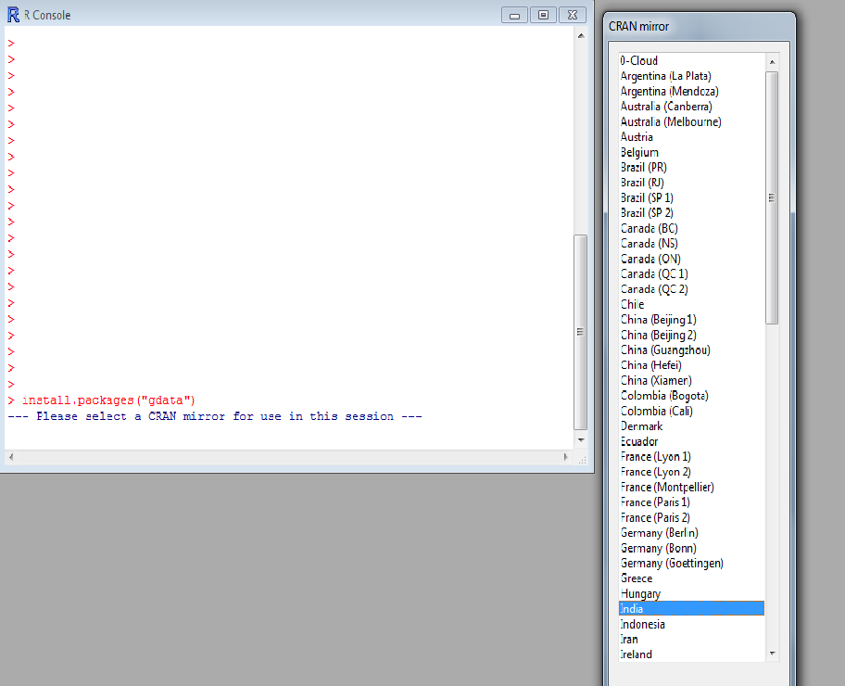
R: Packages
Example
Example:
– Package: ‘gdata’
– Various R programming tools for data manipulation

Slide 26
R: Importing Data
More often than not , data are already available in different
formats ready to be imported to R.
R accepts files of many formats, we will learn importing
files of the following formats:
– Text (.txt)
– CSV (.csv)
– Excel (.xls)
– SPSS ( .sav)
– STATA (.dta)
– SAS (.ssd)
(For more formats you can visit http://cran.rproject.org/doc/manuals/R-data.pdf , here you get
information on how to import image files as well ! )

Slide 27
R: Importing Data
Text , CSV and Excel files
Text Files:
– Comma Delimited Text Files:
data1<- read.table("C:/Users/xyz/Desktop/folderX/mydata.txt",
header=TRUE, sep=",“)
– Space as the separator:
data1<- read.table("C:/Users/xyz/Desktop/folderX/mydata.txt", header=TRUE)
– Another(easier) way, set your working directory then the command is:
data1<- read.table("mydata.txt", header=TRUE)
CSV Files:
– Similar way, use ‘read.csv’ instead of ‘read.table’
Excel Files:
– Use read.xls (needs package ‘gdata’, use ‘library(gadata)’ after installing this package)
– also we can use, read_xls() or read_xlsx() uses library(readxl)

Slide 28
R: Importing Data
From other Statistical Software
SPSS:
– Need library ‘foreign’
– Use command: ‘read.spss’
STATA:
– Need library ‘foreign’
– Use command: ‘read.dta’
SAS:
– Need library ‘foreign’
– Use command: ‘read.ssd’

Slide 29
Working with data.
Accessing columns.
Data1 has our data in it…. But you can’t see it directly.
To select a column use data1$column.

Slide 30
Working with data.
Subsetting data.
Use a logical operator to do this.
  ==, >, <, <=, >=, <> are all logical operators.
  Note that the “equals” logical operator is two == signs.
Example:
  data1[data1$Gender == “M”,]
  This will return the rows of data1 where Gender is “M”.
  Remember R is case sensitive!
  This code does nothing to the original dataset.
  D.M <- data1[data1$Gender == “M”,] gives a dataset with the appropriate rows.

Slide 31

R: Tip 2
For any help on any function just type the following
in the R console:
?’function name’
Or
help(‘function name’)
We don’t see anything here as these commands take you to a webpage where the function and its arguments are explained.

Slide 32
R Objects
Vector is a 1-d array, matrix is a 2-d array.
Arrays in R can have N dimensions
Vectors
  R operates on named data structures.
  The simplest such structure is the numeric vector, which is a single entity consisting of an ordered collection of numbers.
  X<-c(1, 2, 3, 4, 5, 6, 7)
  Assignment operator and c() function
  c(1, 2, 3, 4, 5, 6, 7) ->x is also possible
  1/x gives the reciprocal
  X[i] allows access of individual elements.
  Vector arithmetic's
    C<-2*X
  Character vectors
    characters delimited by the double quote character, e.g., "x-values", "New iteration results".
    C<-”X value”

Slide 33
Objects contd..
Matrix
  M<-matrix(1:9, 3, 3)
  M[1,2]
  Use negative subscripts to remove elements: M [-1,-2] removes 1st row and 2nd column
Arrays
  Z <- array(0, c(3,4))
  a matrix is a 2-dimensional array
Exercise:
Create a vector containing values 1 - 10 and 21 - 35
Change this vector into a 5 x 5 matrix
Extract a 3 x 3 subset from that matrix

Slide 34
Answer
X<-c(1:10,21:35)
Y<-matrix(X,5,5)
Z<-Y[1:3,1:3]

Slide 35
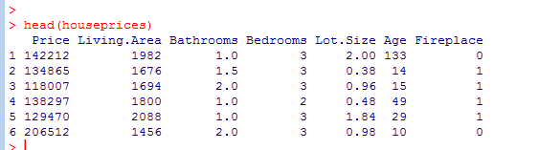
R: Example
The house prices dataset
Lets Explore the dataset

Slide 36
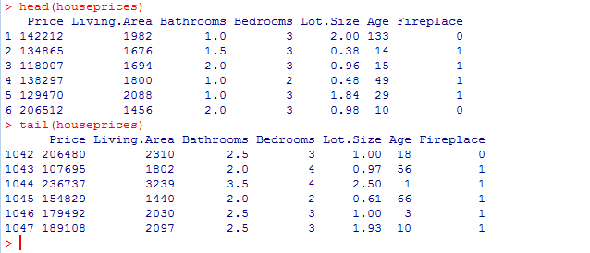
R: Example contd.

Slide 37
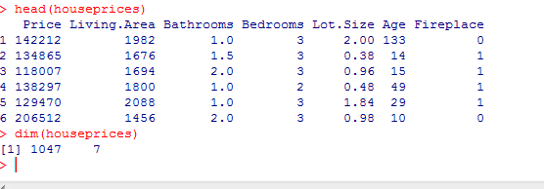
R: Example contd.
Dim
Summary

Slide 38
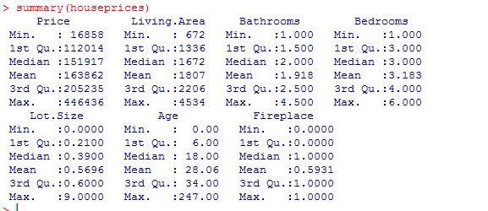
R: Example contd.

Slide 39
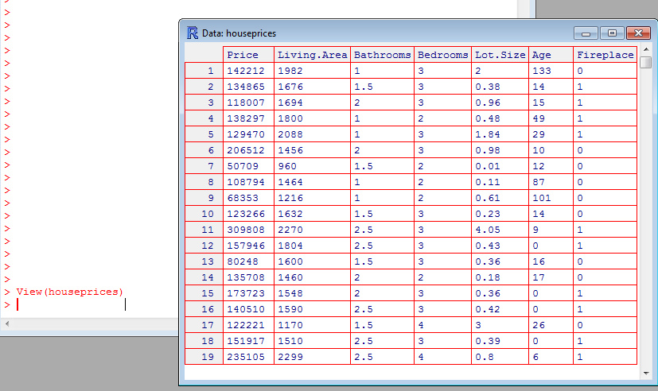
R: Example
View the dataset

Slide 40
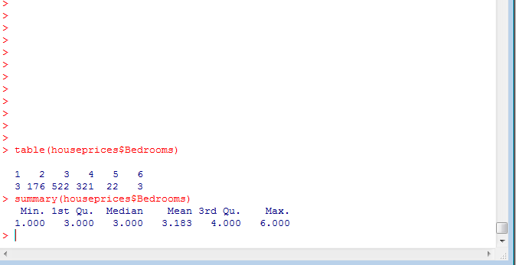
R: Example
Variable Calling
Suppose you want a frequency table of the
‘Bedrooms’ variable:
– Use function ‘table()’

Slide 41
R: Example
Subsets of the data
How to obtain a subset that contains houses whose price is less than or equal to 50,000 Dollars?
-Use the ‘which’ function
Example of ‘which’ function:
Subset1<-data[which(data$Price<=amount),]
Solve for above problem now $$$

Slide 42
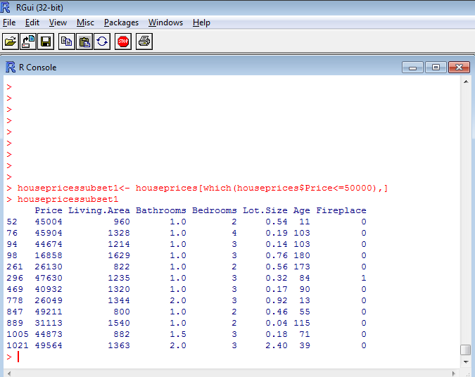
Exercise: 3 Bedroom houses that cost less than 50,000 dollars.

Slide 43
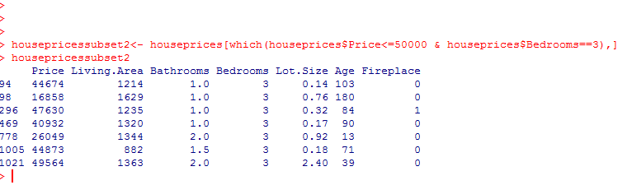
R: Example
Subset of data contd..
3 Bedroom houses that cost less than 50,000 dollars.

Slide 44
Dates
lubridate
install.packages("lubridate")

Slide 45
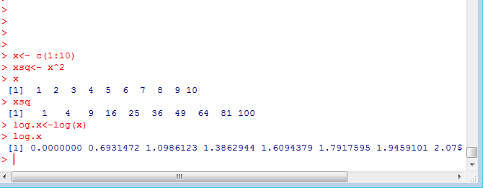
R: Transformations
Squares
Log

Slide 46
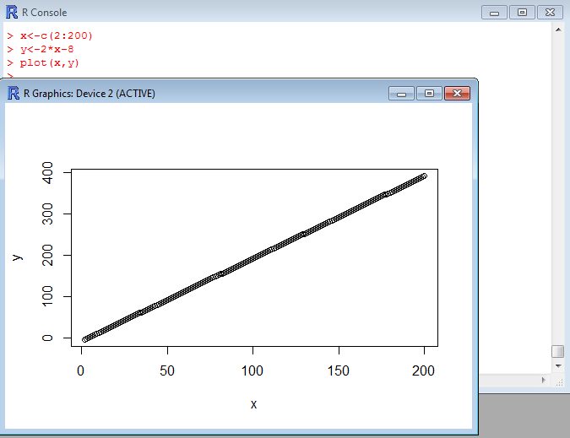
R: Scatter Plots
Suppose we have two variables and we wish to see the relationship between them

Slide 47
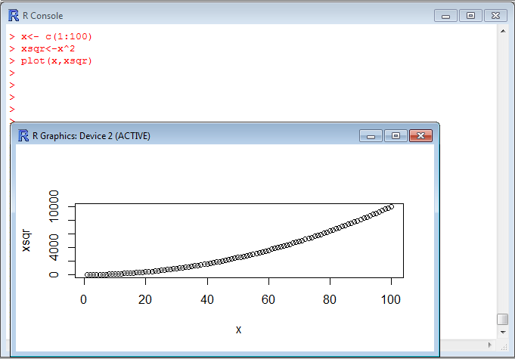
R: Scatter Plots contd..

Slide 48
Useful Commands
Frequency table
– table(variable)
Bar chart
– barplot(table(variable))
• Histogram
– hist(variable)
Box-plot
– boxplot(variable,horizontal=TRUE)
Summary stats
– Mean: mean(variable)
– Variance: var(variable)
– Standard deviation: sd(variable)

Slide 49
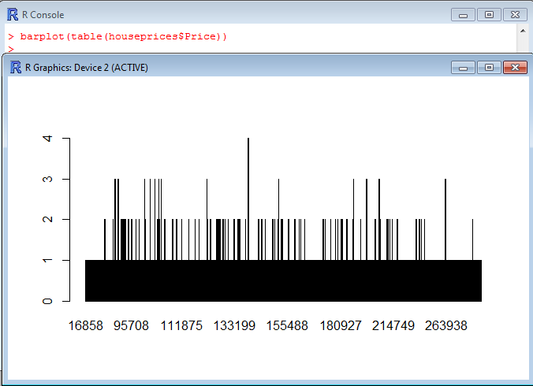
R : barplot

Slide 50
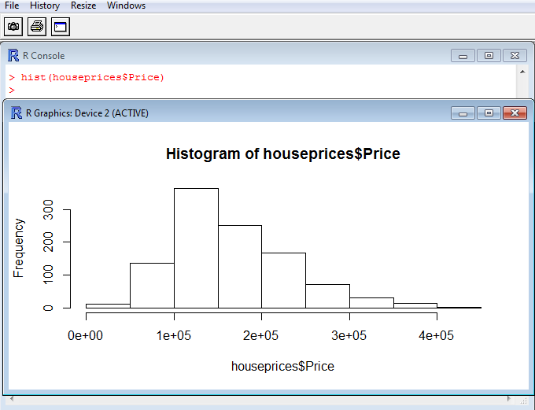
R: histogram

Slide 51
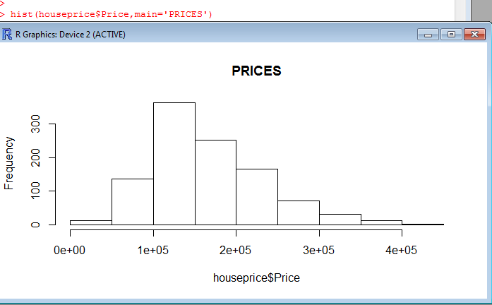
Adding a Title

Slide 52
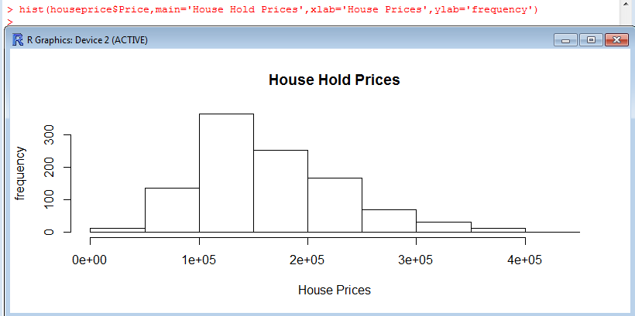
Adding axis labels
Use “xlab” and “ylab” to label the X and Y axes, respectively.

Slide 53
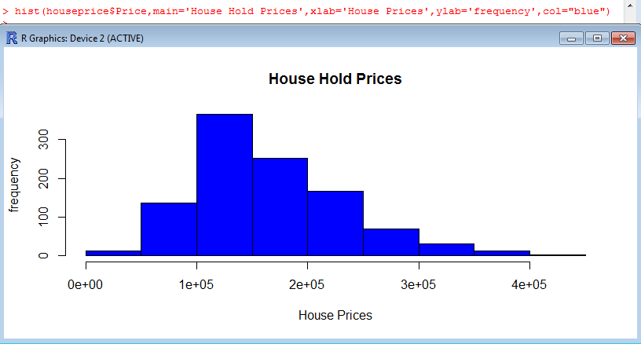
Changing colors
Use the col statement.
  ?colors will give you help on the colors.
  Common colors may simply put in using the name.

Slide 54
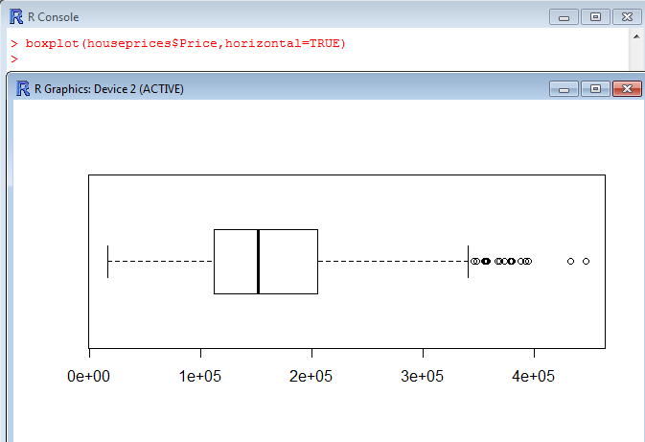
R : boxplot
In descriptive statistics , a box plot or boxplot is a convenient way of graphically depicting groups of numerical data through their quartiles.

Slide 55
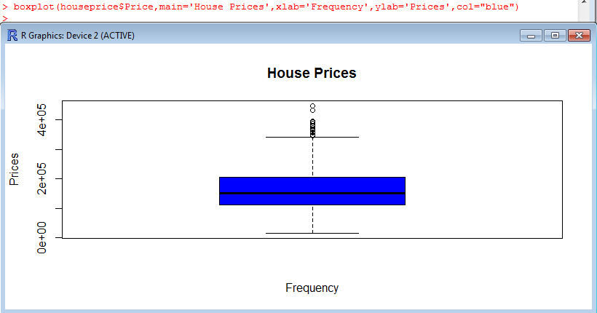
Boxplot

Slide 56
Paneling Graphics
Suppose we want more than one graphic on a panel.
We can partition the graphics panel to give us a framework in which to panel our plots.
par(mfrow = c( nrow, ncol))
Number of rows
Number of columns

Slide 57
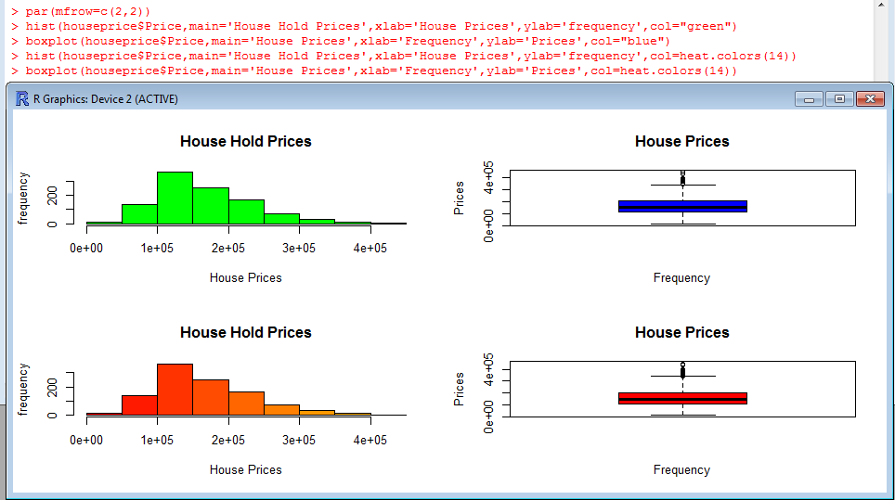
Paneling Graphics

Slide 58
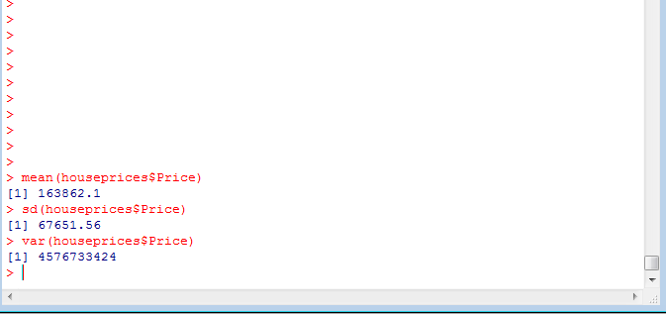
R: summary stats

Slide 59
R: Questions
How can I save my work?
You can save all the objects and functions that you have created in an .RData file, by using the save or the save.image functions. It is very important that you remember to include the .RData extension when indicating the file path because R will not supply it for you!
save(file="d:/file_name.RData")
save.image("d:/file_name.RData")
On a PC you can also access this through the file menu:
File Save workspace browse to the folder where you want to save the file and supply the file name of your choice

Slide 60
R: Questions Contd.
How can I retrieve the work that I have saved using a save.image function?
The load function will load an .RData file.
load("d:/file_name.RData")
On a PC you can also access this through the file menu:
File Load workspace browse to the folder where you saved
the .RData file and click open

Slide 61
R: Questions Contd.
How do I save all the commands that I have used in an R session?
You can save a history of your R session in an .Rhistory file by using the history function.
It is very important that you remember to include the .Rhistory extension when indicating the file path because R will not supply it for you!
history("d:/file_name.Rhistory")
On a PC you can also access this through the file menu:
File Save history browse to the folder where you want to save the file and supply the file name of your choice

Slide 62
R: Questions Contd.
How can I retrieve the work that I have saved using a history function?
The loadhistory function will load an .Rhistory file.
loadhistory("d:/file_name.Rhistory")
On a PC you can also access this through the file menu:
File-- Load history
browse to the folder where you saved the .Rhistory file and click open

Slide 63
R: Questions Contd.
How can I see a list of the objects that are currently available?
objects()
ls()
How do I remove unwanted objects and functions?
rm(object_name1, object_names2, etc.) rm(function_name1, function_name2, etc.)

Slide 64
R studio/R help
A free and open source integrated development environment (IDE) for R
Can be downloaded from http://www.rstudio.com/
Rseek : An exclusive R search engine
More help and resources:
– R-bloggers
– UCLA’s R help
– Quick-r
– R-help
Google!!!!!!!

